Slide 1
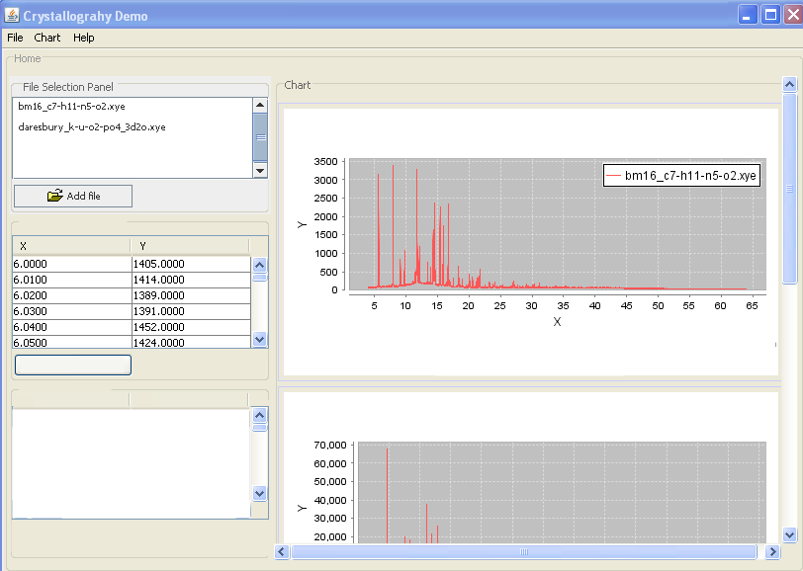
(s)
Data in focus
Save modified data
Data properties
Name
Value
Type x-ray
Wavelenght unknown
.
.
Etc.

